Slide 1
Chapter 10
Architectural Design

Slide 2
Objectives
To introduce architectural design and to discuss its importance
To explain the architectural design decisions that have to be made
To introduce three complementary architectural styles covering organisation, decomposition and control
To discuss reference architectures are used to communicate and compare architectures

Slide 3
Topics covered
Architectural design decisions
Architecture styles
Decomposition styles
Control styles
Reference architectures

Slide 4
What is software architecture design?
An early stage of the system design process.
The design process for identifying the sub-systems making up a system and the framework for sub-system control and communication is architectural design.
The output of this design process is the software architecture.

Slide 5
What is software architecture?
Software architecture has emerged as an important sub-discipline of software engineering, particularly in the realm of large-system development.
It utilizes “divide and conquer” strategy.
it allows groups to work cooperatively and productively together to solve a much larger problem than any of them would be capable of individually.

Slide 6
What is software architecture? (continued)
Architecture is a big picture of, a skeleton of , a holistic view of the system:
  漫画：
  模特：三围
It is not the operational software, a thinking, plan etc.
In RUP, architecture is centric

Slide 7
Why Architecture ?
Stakeholder communication
  Architecture may be used as a focus of discussion by system stakeholders.
System analysis
  Means that analysis of whether the system can meet its non-functional requirements is possible.
Large-scale reuse
  The architecture may be reusable across a range of systems.

Slide 8
Architecture and system characteristics
Architecture affects the system characteristics of a system , such as performance, robustness, and maintainability etc.
Performance
  Localise critical operations and minimise communications. Use large rather than fine-grain components.
Security
  Use a layered architecture with critical assets in the inner layers.

Slide 9
Architecture and system characteristics
Safety
  Localise safety-critical features in a small number of sub-systems.
Availability
  Include redundant components and mechanisms for fault tolerance.
Maintainability
  Use fine-grain, replaceable components.

Slide 10
Architectural conflicts
Using large-grain components improves performance but reduces maintainability.
Introducing redundant data improves availability but makes security more difficult.
Localising safety-related features usually means more communication so degraded performance.

Slide 11
architectural design
Concerned with decomposing the system into interacting sub-systems.
The architectural design is normally expressed as a block diagram presenting an overview of the system structure.

Slide 12
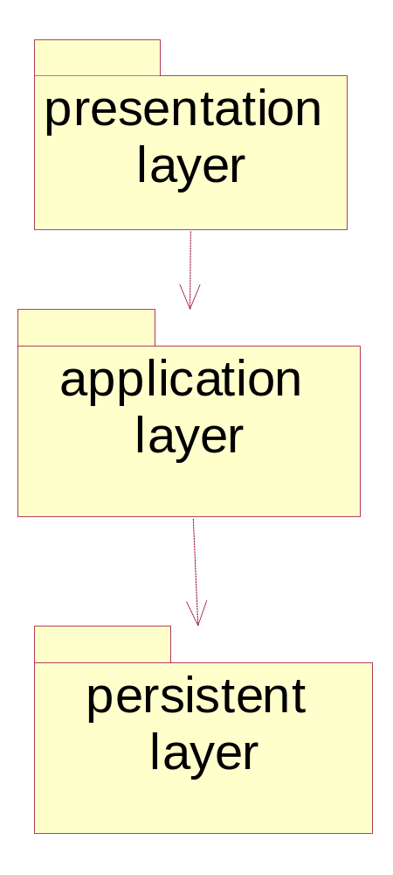
Architecture examples –OO with UML

Slide 13
Architectural design decisions
Architectural design is a creative process so the process differs depending on the type of system being developed.
However, a number of common decisions span all design processes.

Slide 14
Architectural design decisions
Is there a generic application architecture that can be used?
How will the system be distributed?
What architectural styles are appropriate?
What approach will be used to structure the system?
How will the system be decomposed into modules?
What control strategy should be used?
How will the architectural design be evaluated?
How should the architecture be documented?

Slide 15
Architecture reuse
Systems in the same domain often have similar architectures that reflect domain concepts.
For embedded and PC system, there is usually only a single processor, no need to design a distributed architecture for the system.
Most large systems are now distributed system, where a distributed architecture is needed.

Slide 16
Architectural models
Used to document an architectural design.
Static structural model that shows the major system components.
Dynamic process model that shows the process structure of the system.
Interface model that defines sub-system interfaces.
Relationships model such as a data-flow model that shows sub-system relationships.
Distribution model that shows how sub-systems are distributed across computers.

Slide 17
Architectural styles
The architectural model of a system may conform to a generic architectural model or style.
An awareness of these styles can simplify the problem of defining system architectures.
However, most large systems are heterogeneous and do not follow a single architectural style.
Style is also a template for construction.

Slide 18
Some typical architecture styles
Three styles are widely used:
  A shared data repository style;
  A shared services and servers style;
  An layered or abstract machine style.

Slide 19
The data repository model
Sub-systems must exchange data. This may be done in two ways:
  Shared data is held in a central database or repository and may be accessed by all sub-systems;
  Each sub-system maintains its own database and passes data explicitly to other sub-systems.
When large amounts of data are to be shared, the repository model of sharing is most commonly used.

Slide 20
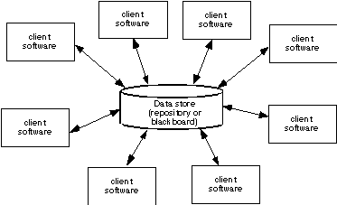
Data centered architecture

Slide 21
Repository model characteristics
Advantages
  Efficient way to share large amounts of data;
  Sub-systems need not be concerned with how data is produced Centralised management e.g. backup, security, etc.
  Sharing model is published as the repository schema.

Slide 22
Repository model characteristics (continued)
Disadvantages
  Sub-systems must agree on a repository data model. Inevitably a compromise;
  Data evolution is difficult and expensive;
  No scope for specific management policies;
  Difficult to distribute efficiently.

Slide 23
Client-server model
Distributed system model which shows how data and processing is distributed across a range of components.
Set of stand-alone servers which provide specific services such as printing, data management, etc.
Set of clients which call on these services.
Network which allows clients to access servers.

Slide 24
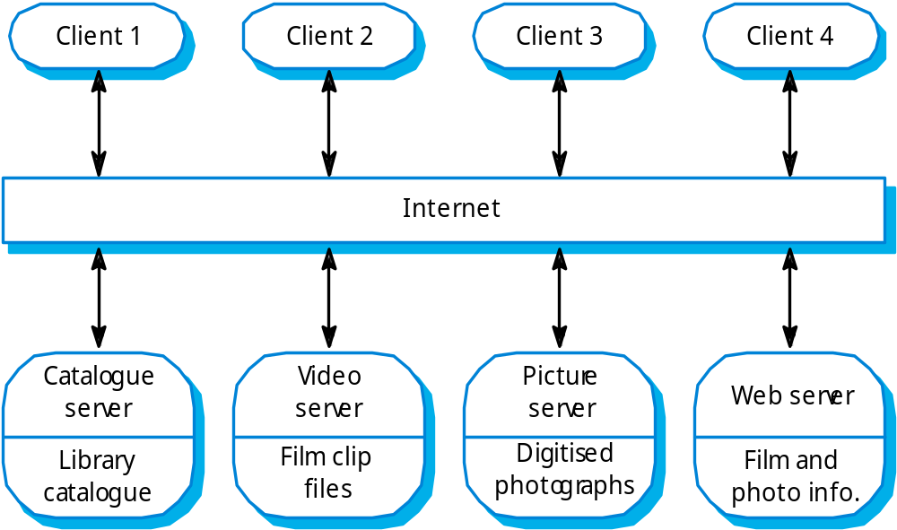
Film and picture library

Slide 25
Client-server characteristics
Advantages
  Distribution of data is straightforward;
  Makes effective use of networked systems. May require cheaper hardware;
  Easy to add new servers or upgrade existing servers.

Slide 26
Client-server characteristics (continued)
Disadvantages
  No shared data model so sub-systems use different data organisation. Data interchange may be inefficient;
  Redundant management in each server;
  No central register of names and services - it may be hard to find out what servers and services are available.

Slide 27
Abstract machine (layered) model
Used to model the interfacing of sub-systems.
Organises the system into a set of layers (or abstract machines) each of which provide a set of services.
Supports the incremental development of sub-systems in different layers. When a layer interface changes, only the adjacent layer is affected.
However, often artificial to structure systems in this way.

Slide 28
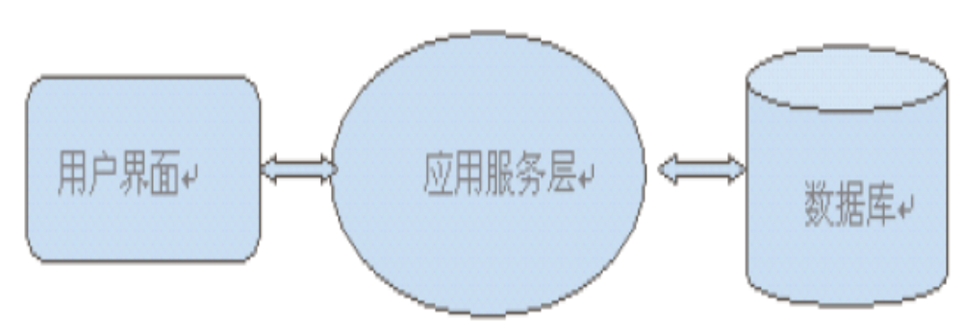
A three tier pattern

Slide 29
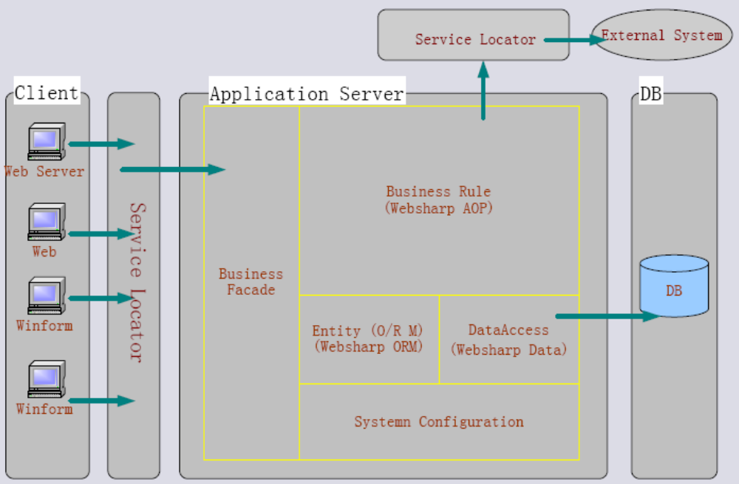
A three tier pattern---refine each tier

Slide 30
Note on architecture style
In many cases, more than one style might be appropriate, and then combination styles are used for one system.
A layered style is appropriate for most systems.
In many database applications, a layered style can be combined with a data-centered architecture.

Slide 31
Modular decomposition styles
Decisions on how to decompose subsystem into smaller modules:
Styles of decomposing sub-systems into modules.

Slide 32
Sub-systems and modules
A sub-system is a system in its own right whose operation is independent of the services provided by other sub-systems.
A module is a system component that provides services to other components but would not normally be considered as a separate system.
A module usually is smaller than a subsystem.

Slide 33
Modular decomposition
Another structural level where sub-systems are decomposed into modules.
Two modular decomposition models covered
  An object model where the system is decomposed into interacting object;
  A pipeline or data-flow model where the system is decomposed into functional modules which transform inputs to outputs.

Slide 34
Object models
Structure the system into a set of loosely coupled objects with well-defined interfaces.
Object-oriented decomposition is concerned with identifying object classes, their attributes and operations.
When implemented, objects are created from these classes and some control model used to coordinate object operations.

Slide 35
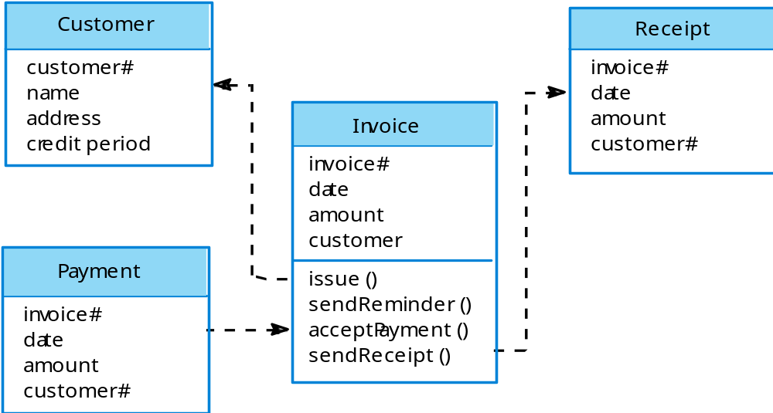
Invoice processing system

Slide 36
Object model advantages
Objects are loosely coupled so their implementation can be modified without affecting other objects.
The objects may reflect real-world entities.
OO implementation languages are widely used.

Slide 37
Function-oriented pipelining
Functional transformations process their inputs to produce outputs.
May be referred to as a pipe and filter model.
Variants of this approach are very common. When transformations are sequential, this is a batch sequential model which is extensively used in data processing systems.
Not really suitable for interactive systems.

Slide 38
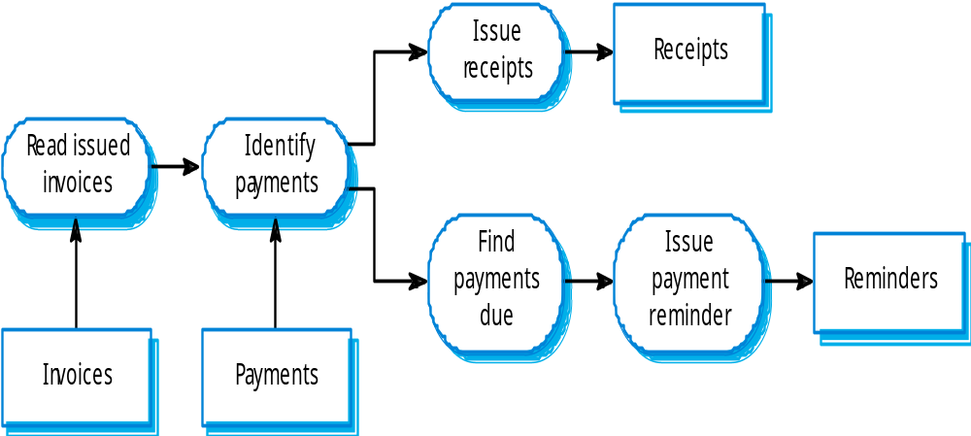
Invoice processing system

Slide 39
Pipeline model advantages
Supports transformation reuse.
Intuitive organisation for stakeholder communication.
Easy to add new transformations.
Relatively simple to implement as either a concurrent or sequential system.
However, requires a common format for data transfer along the pipeline and difficult to support event-based interaction.

Slide 40
Control styles
Are concerned with the control flow between sub-systems. Distinct from the system decomposition model.
Centralised control
  One sub-system has overall responsibility for control and starts and stops other sub-systems.
Event-based control
  Each sub-system can respond to externally generated events from other sub-systems or the system’s environment.

Slide 41
Centralised control
A control sub-system takes responsibility for managing the execution of other sub-systems.
Call-return model
  Top-down subroutine model where control starts at the top of a subroutine hierarchy and moves downwards. Applicable to sequential systems.
Manager model
  Applicable to concurrent systems. One system component controls the stopping, starting and coordination of other system processes. Can be implemented in sequential systems as a case statement.

Slide 42
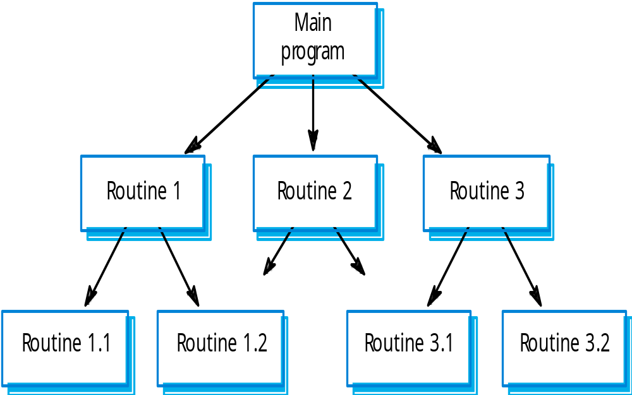
Call-return model

Slide 43
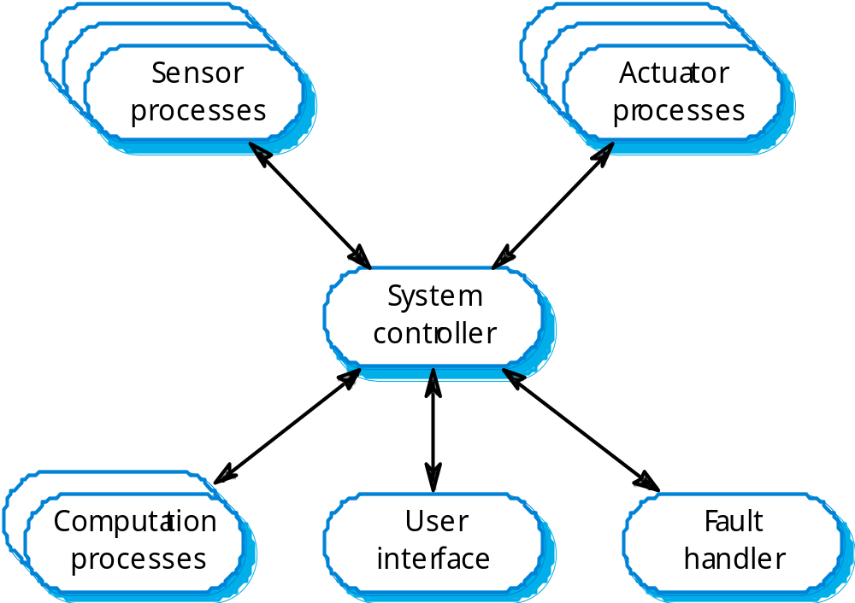
Real-time system control

Slide 44
Event-driven systems
Driven by externally generated events where the timing of the event is outside the control of the sub-systems which process the event.
Two principal event-driven models
  Broadcast models. An event is broadcast to all sub-systems. Any sub-system which can handle the event may do so;
  Interrupt-driven models. Used in real-time systems where interrupts are detected by an interrupt handler and passed to some other component for processing.

Slide 45
Broadcast model
Effective in integrating sub-systems on different computers in a network.
Sub-systems register an interest in specific events. When these occur, control is transferred to the sub-system which can handle the event.
Control policy is not embedded in the event and message handler. Sub-systems decide on events of interest to them.
However, sub-systems don’t know if or when an event will be handled.

Slide 46
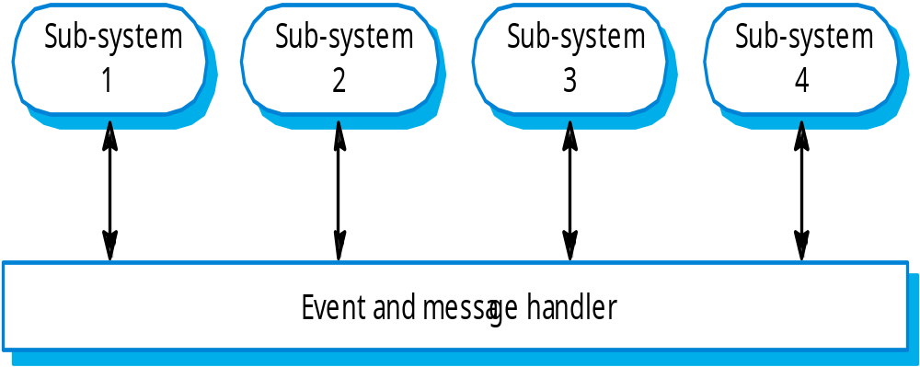
Selective broadcasting

Slide 47
Interrupt-driven systems
Used in real-time systems where fast response to an event is essential.
There are known interrupt types with a handler defined for each type.
Each type is associated with a memory location and a hardware switch causes transfer to its handler.
Allows fast response but complex to program and difficult to validate.

Slide 48
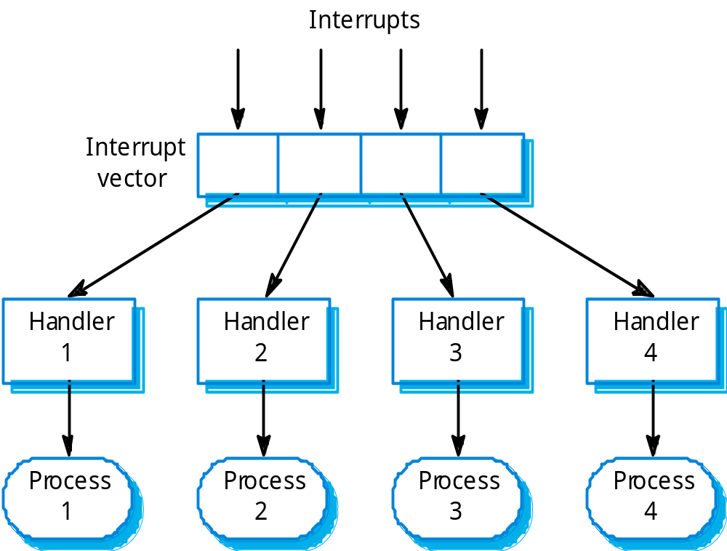
Interrupt-driven control

Slide 49
Reference architectures
Architectural models may be specific to some application domain.
Two types of domain-specific model
  Generic models which are abstractions from a number of real systems and which encapsulate the principal characteristics of these systems.
  Reference models which are more abstract, idealised model. Provide a means of information about that class of system and of comparing different architectures.
Generic models are usually bottom-up models; Reference models are top-down models.

Slide 50
Reference architectures
Reference models are derived from a study of the application domain rather than from existing systems.
May be used as a basis for system implementation or to compare different systems. It acts as a standard against which systems can be evaluated.
OSI model is a layered model for communication systems.

Slide 51
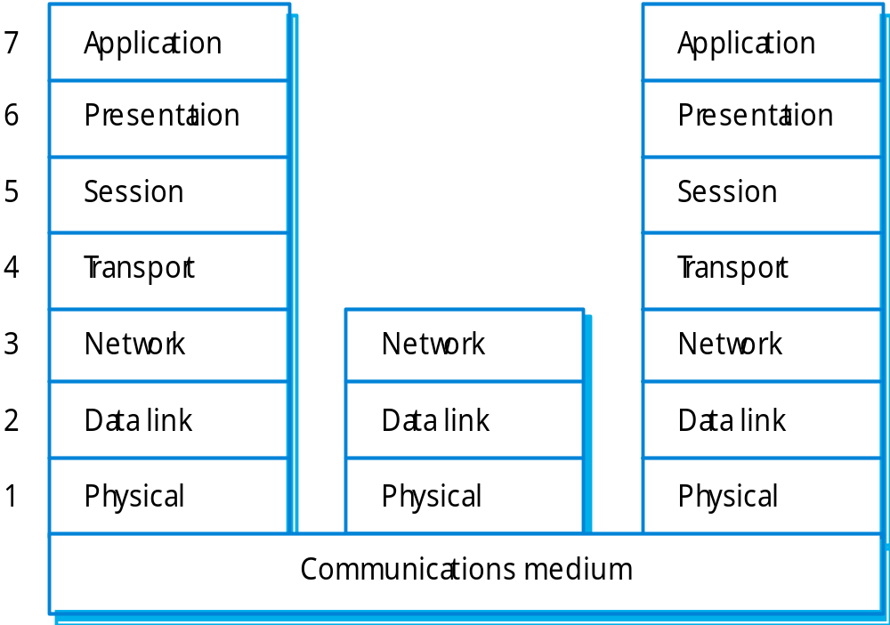
OSI reference model

Slide 52
Architecture and framework
They are distinct
Architecture is a kind of thinking, system blueprint, which determines subsystems and its interfaces etc. such as MVC, Java EE
Framework is a semi-realization of a architecture, such as JSF, Struts

Slide 53
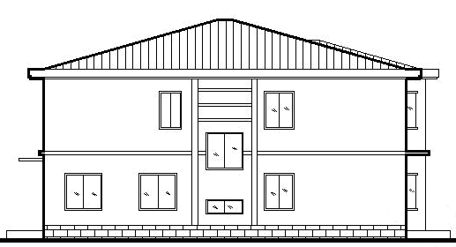
When use architecture and framework?
9简单需求
简单需求

Slide 54
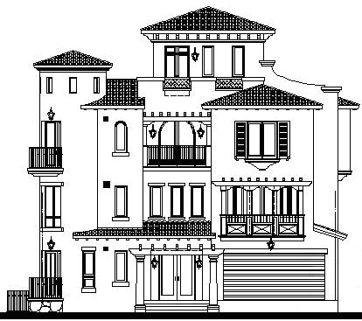
复杂需求

Slide 55
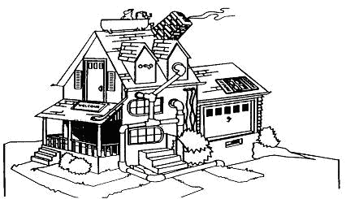
没有软件架构设计的结果

Slide 56
When framework?
I strongly suggest each system should make use of Framework to reduce effort, error, and many other benefits.

Slide 57
Key points
The software architecture is the fundamental framework for structuring the system.
Architectural design decisions include decisions on the application architecture, the distribution and the architectural styles to be used.
Different architectural models such as a structural model, a control model and a decomposition model may be developed.
System organisational models include repository models, client-server models and abstract machine models.

Slide 58
Key points
Modular decomposition models include object models and pipelining models.
Control models include centralised control and event-driven models.
Reference architectures may be used to communicate domain-specific architectures and to assess and compare architectural designs.

